Slide 1
Hi.
Let’s get started.
Notes:
***Remember to set your slide show to presenter mode***
Visit http://office.microsoft.com/en-us/powerpoint-help/what-is-presenter-view-HA010360603.aspx or ask your PLEF to show you how.

Slide 2



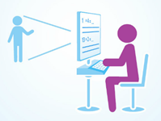

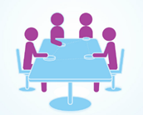

Student Boot Camp
Make it personal.
http://prezi.com/ctso5dj9gkbi/school-of-one/

Slide 3
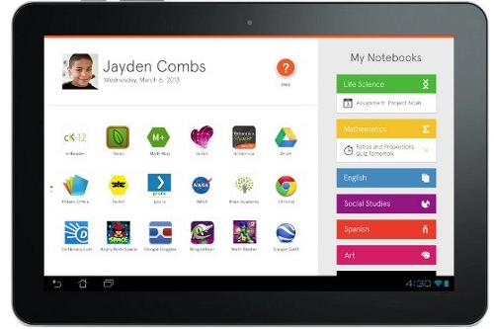


Slide 4
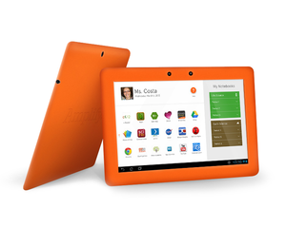
Today’s Goals
Tablet basics
Help!
What happens if I lose, break or someone steals my tablet?
Notes:
Know your way around the Amplify tablet
Know how to get help with your tablet
Know what will happen if your tablet is lost, stolen, or broken

Slide 5
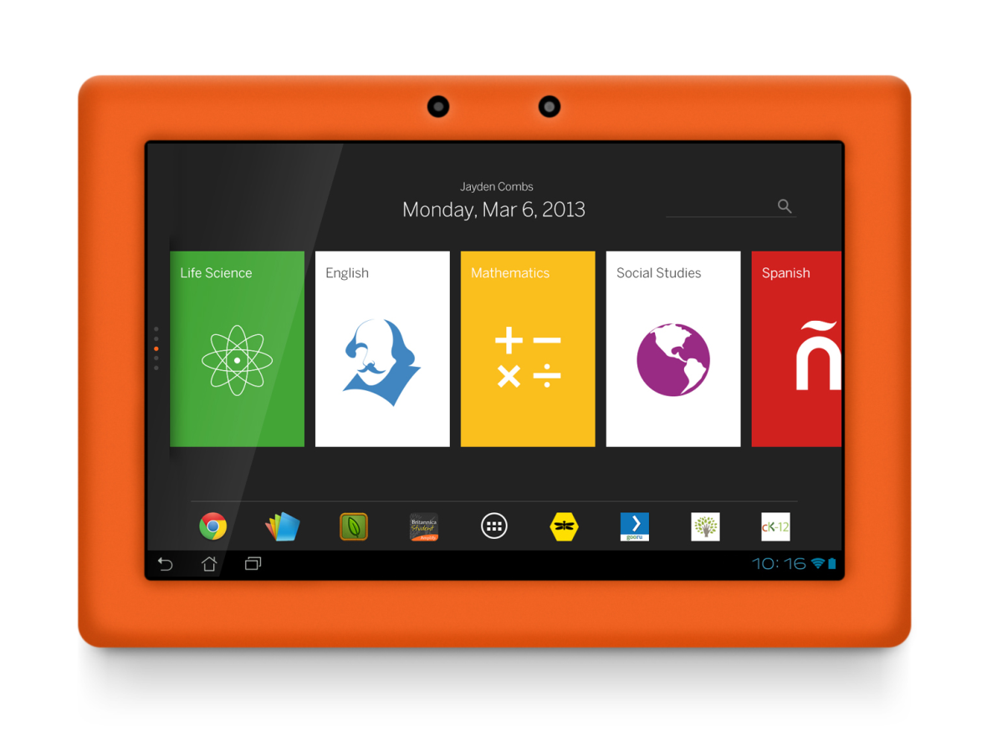
Today’s Goals
Acceptable Use Policy (AUP)
How to use the tablet for schoolwork
All about Apps
Create!
Notes:
Understand the Acceptable Use Policy and the consequences for not following
Be able to identify and use the core apps available on the tablet
Create a product that shows your understanding of today’s topics

Slide 6
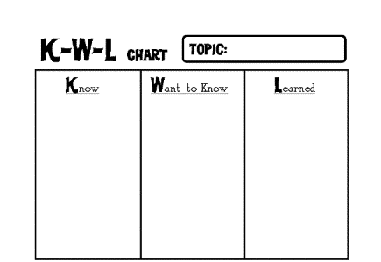
Amplify Tablet
What would you like to know about the Amplify tablet?
What do you know about you tablets?
Notes:
We’ve all seen this before, but this time we’re going to do it a little differently. I want you to ….
Create a KWL chart on the board or a flip chart. Do not immediately erase as you will refer back to this throughout the morning session.
***If paper is not available, please use the whiteboard in your classroom.

